Slide 1
Making this resource work for you
Prior to teaching this lesson, please refer to the ‘Unit Overview and Planning Document’.
Further guidance on planning Science Mastery lessons can be found in the detailed planning guidance document.
Refer to the ‘notes’ section on each slide for useful information, including suggested expositions, pedagogical content knowledge, suggested questions, answers and more. Consider using presenter mode so you can see this guidance throughout the lesson.
The introduction slides can be adapted to suit your teaching style and the needs of your class.
Before the lesson, adapt the fix-it slide to address any misconceptions identified in the previous lesson’s exit ticket.
Choose from the suggested activities to suit your class. The intention is not that you complete all of these, but that you select those which ones are most appropriate for your students. It may be appropriate to further adapt activities for your students.
These lessons are designed to occupy approximately 1 hour. To adapt for a shorter or longer lesson duration we advise you to adapt the activity section accordingly.
Please consider using the final slide to send feedback about this lesson or examples of PowerPoints that you have adapted to our design team. Your feedback is used to improve Science Mastery for all of our teachers and students. We appreciate all suggestions and comments.
Thank you for reading!
The Science Mastery Team

Slide 2

Taking it Further: Esters
Answer the questions below.
Name the functional group found in carboxylic acids.
State the chemical formula of methanoic acid.
Name the homologous series that contain a C=C double bond.
Name the alcohol that contains two carbon atoms.
Give a use of ethanol.
Carboxyl group
COOH
Alkenes
Ethanol
In alcoholic drinks, as a fuel or a solvent
Notes:
Big idea: Reactions rearrange matter
Foundation: State the formula of ethanoic acid.
Stretch: Explain what is meant by a functional group.
Answers:
Foundation: CH₃COOH
Stretch: The series of atoms that is found in a given homologous series and is responsible for the chemical properties.

Slide 3
Taking it Further: Esters
Do Now:
Name the functional group found in carboxylic acids.
State the chemical formula of methanoic acid.
Name the homologous series that contain a C=C double bond.
Name the alcohol that contains two carbon atoms.
Give a use of ethanol.
Drill:
Draw the structural formula of ethene.
Draw the structural formula of ethanol.
Draw the structural formula of ethanoic acid.

Slide 4
Taking it Further: Esters
Read Now:
If you look on the ingredients lists on many scented cleaning products or fragrances, you may see compounds with names like methyl butanoate. Esters are organic compounds that usually have fruity smells and can be used as solvents, making them useful in scented products. Esters are formed through the chemical reaction between alcohols and carboxylic acids. In any chemical reaction, the properties of the new substance or compound formed is different to the substances or compounds it is formed from. We can use the names of the alcohols and the carboxylic acids that react to determine the name of the ester and the number of carbon atoms that would be found in a molecule.
Explain why esters are useful in scented products.
Describe how an ester is formed.
Compare the properties of the product of a chemical reaction with the properties of the reactants.
Describe how we can determine the name of an ester.

Slide 5

C5.1.11
15/08/2024
Taking it Further: Esters
C5.1.1 Prior Knowledge Review
C5.1.2 Crude Oil and Hydrocarbons
C5.1.3 Fractional Distillation
C5.1.4 Combustion of Hydrocarbons
C5.1.5 Cracking
C5.1.6 Taking it Further: Alkenes
C5.1.7 Taking it Further: Alcohols
C5.1.8 Taking it Further: Producing Ethanol by Fermentation
C5.1.9 Taking it Further: Producing Ethanol from Ethene
C5.1.10 Taking it Further: Carboxylic Acids
C5.1.11 Taking it Further: Esters
C5.1.12 Polymers
C5.1.13 Taking it Further: Addition Polymerisation
C5.1.14 Taking it Further: Condensation Polymerisation
C5.1.15 Taking it Further: Naturally Occurring Polymers
Notes:
Big Idea: Structure Determines Properties
In this lesson, students will further develop their understanding of alcohols and carboxylic acids and consolidate their knowledge of different homologous series and uses.
Suggested Hook:
If possible, you can show students a perfumed product with the ingredients list, including various different esters.

Slide 6

Following this lesson, students will be able to:
Describe how esters are formed
State the general equation for the formation of esters
Describe uses of esters
Key Words:
carboxylic acid
alcohol
ester
solvent
ethyl ethanoate
Notes:
Guidance:
See unit overview document and planning guidance to see how these objectives are typically assessed at GCSE, including examples of what students should be able to do following this lesson.
Planning for different needs:
The learning objectives given on this slide are suggested based on the most common requirements for exams, however they can be adapted based on the needs of different classes.
For best practice, the unit preparation booklet should be used to determine the appropriate focus of lessons within the unit.
While it is not possible to explicitly split content into levelled grades, we recommend that lesson objectives can be classified as critical, core or stretch.
Critical: the content or skill is essential for all students to be able to progress.
Core: the content or skill is important for students to progress, but other opportunities may be available to revisit it.
Stretch: the content or skill may not be essential for all students but is important for students aiming for the highest grades.
Key skill: this is a crucial skill being developed in this unit as part of the skill mapping
C5.1.11 Lesson Objectives:
Core: Describe how esters are formed
Critical: State the general equation for the formation of esters
Core: Describe uses of esters

Slide 7
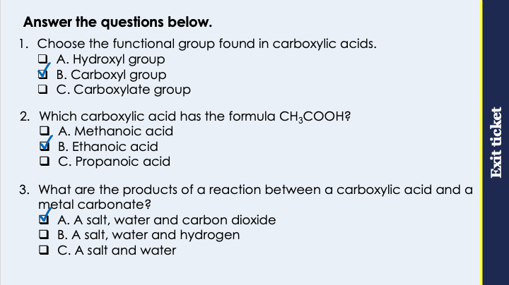
This is the fix-it portion of the lesson
The fix-it is an opportunity to respond to gaps in knowledge, especially those identified by the pre-unit quiz.
The teacher should customise this slide as needed, to facilitate
reteach, explanation, demonstration or modelling of ideas and concepts that students have not yet grasped or have misunderstood.
practise answering specific questions or of key skills.
redrafting or improving previous work.
Notes:
Purpose: to spend time on any gaps identified in previous learning from previous exit ticket.
Guidance from previous exit ticket:
Q1. Answer: B
If students answer A, they have confused the functional groups of the alcohols and carboxylic acids. If students answer C, they have confused the naming of salts with the functional group, which is also a common mistake. To fix-it, review the names and formulae of functional groups from different homologous series.
Q2. Answer: B
If students answer A, they have made the common mistake of ignoring the carbon from the functional group. If students answer C, they are not secure with the naming convention prefixes for organic compounds. To fix it, review the prefixes used for different numbers of carbon atoms and give students practice identifying and drawing their displayed formulae.
Q3. Answer: A
If students answer B or C, they have not identified the products of acid and carbonate reactions. To fix it, review the general equations for reactions between acids and metals, acids and alkalis and acids and metal carbonates.

Slide 8
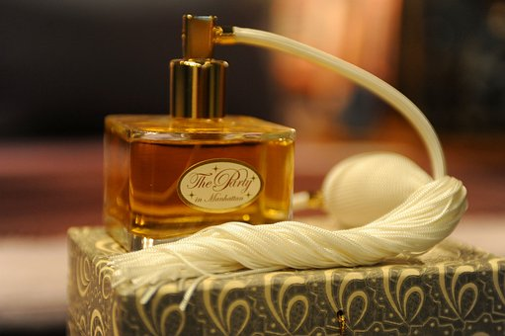

Esters
Carboxylic acids can react with alcohols to form esters.
Esters have fruity smells and can be used as solvents.
The general equation for the formation of esters is:
Alcohol + carboxylic acid → ester + water
For example:
Ethanol + ethanoic acid → ethyl ethanoate + water
Notes:
Suggested exposition:
In the last lesson we looked at carboxylic acids.
Carboxylic acids can react with alcohols to form esters.
Esters are another homologous series of organic compounds.
If possible, it is useful to let students smell a couple of different esters. Please consult CLEAPPS for most up to date guidance, but some suggestions are:
butyl butanoate, which smells like pineapple
ethyl butanoate, which smells like banana
ethyl heptanoate, which smells like apricot
Esters generally have fruity smells, so they are often used in different scented products. They are also useful as solvents.
What is a solvent?
A substance (liquid) in which a solute can dissolve.
The general equation for the formation of esters is:
alcohol + carboxylic acid → ester + water
For example, ethanol + ethanoic acid → ethyl ethanoate + water
This is the only ester that you will need to know the name of from the reactants, but this is an important part of organic chemistry at A-Level.
We can determine the ester that will be formed from the alcohol and the carboxylic acid that reacted to make it.
Images from pixabay

Slide 9
Formation of Esters
Ethanol + ethanoic acid → ethyl ethanoate + water
H
H
H
C
C
O
H
H
H
O
H
H
→
H
H
O
H
C
C
O
C
C
H
+
C
C
H
H
O
H
H
H
H
+
H
O
H
Notes:
Suggested exposition:
Let’s look at what actually happens in the reaction when an ester is formed. We will use ethanol and ethanoic acid as our example.
Animate ethanol and ethanoic acid.
For the purposes of this, we have moved the functional group of the carboxylic acid to the other side, so we can see what happens to the atoms.
What is the functional group of the carboxylic acids?
-COOH (carboxyl group)
What is the functional group of the alcohols?
-OH (hydroxyl group)
These functional groups are responsible for the reactivity of the compounds.
Why do these compounds both have the prefix ‘eth-’?
Because they each contain two carbon atoms.
When an alcohol reacts with a carboxylic acid, the hydrogen atom from the functional group of the alcohol joins with the OH from the functional group of the carboxylic acid.
What would be the formula of the small molecule formed here?
Water. It has formed H₂O.
This is called a condensation reaction, because it produces water as a product. You may also hear this process described as esterification because it is the production of an ester.
The leftover oxygen atom on the alcohol joins with the carbon from the carboxylic acid. This forms the ester.
The other product of the reaction is water.
So where does the name of the ester come from?
Just like when we are naming salts, parts of the names of both the reactants are involved. The first part is from the alcohol, which in this case in ethanol. This makes the ethyl part of the name. You can identify this part of the molecule because it is the side that does not contain the C=O double bond.
The second part of the ester name is from the carboxylic acid and ends ‘oate’, so in this case ethanoic acid forms ethanoate.
This gives us the full name of the ester formed from ethanol and ethanoic acid as ethyl ethanoate.
Animate turquoise circle.
The functional group of the esters is this group, which can be written as COO or OCO. This is how to identify an ester.

Slide 10
Which is the correct displayed formula of ethyl ethanoate?
A
B
H
O
H
H
H
H
H
H
H
C
C
C
C
H
H
C
C
O
C
C
H
H
H
H
H
H
H
H
C
D
H
H
OH
H
H
H
O
H
H
C
C
O
C
C
H
H
C
C
O
C
C
H
H
H
H
H
H
H
Notes:
Suggested points:
D is the correct displayed formula. None of the others contain the COO functional group.
Suggested guidance:
Talk tasks can be used in a variety of ways to suit the particular needs of the students you are teaching. Through exchanging views with others, students develop their understanding of the science beyond what could be achieved individually.
Science classrooms that successfully integrate talk have the following features:
Science talk is a regular feature of lessons and is woven into classroom activities.
Students are paired or grouped strategically by the teacher to ensure productive interaction. This might take into consideration the students’ proficiency of the English language, how encouraging they might be to peers and their attainment in the topic. It’s a good idea to consider these pairings in the class seating plan.
Students are encouraged and supported to talk, but are not forced to talk.
The teacher should take on the role of a facilitator, engaging with conversations where necessary and encouraging or steering the conversation where needed.
Students are encouraged to use the language they have to express their ideas (e.g., everyday language, imperfect English, native language), but also to incorporate science specific terminology where this is more accurate or has been taught.
6. Scientifically inaccurate ideas are not dismissed by the partner or teacher; open discussion and further investigation are relied on to help students construct ideas that support them to progress in their scientific understanding.
7. Guidelines for behaviour during talk tasks are explicit and frequently reviewed. Rules for students might be:
Listen carefully to your partner
Take turns talking.
Speak one at a time, without interrupting.
Politely agree or disagree and explain why.
Politely point out if your partner has used a scientific word incorrectly, if they have explained the science incorrectly, or if there is a more accurate way to describe something.
If confused, ask questions.
Stay focused on the discussion topic.
Respond to one another.

Slide 11
How many carbon atoms are present in each of these esters? Stretch: what reactants were used to make these esters?
Methyl butanoate
Propyl ethanoate
Ethyl methanoate
Butyl propanoate
5 carbons total
Methanol + butanoic acid
1
4
5 carbons total
Propanol + ethanoic acid
3
2
2 carbons total
Ethanol + methanoic acid
2
1
7 carbons total
Butanol + propanoic acid
4
3
Notes:
Suggested guidance:
Talk tasks can be used in a variety of ways to suit the particular needs of the students you are teaching. Through exchanging views with others, students develop their understanding of the science beyond what could be achieved individually.
Science classrooms that successfully integrate talk have the following features:
Science talk is a regular feature of lessons and is woven into classroom activities.
Students are paired or grouped strategically by the teacher to ensure productive interaction. This might take into consideration the students’ proficiency of the English language, how encouraging they might be to peers and their attainment in the topic. It’s a good idea to consider these pairings in the class seating plan.
Students are encouraged and supported to talk, but are not forced to talk.
The teacher should take on the role of a facilitator, engaging with conversations where necessary and encouraging or steering the conversation where needed.
Students are encouraged to use the language they have to express their ideas (e.g., everyday language, imperfect English, native language), but also to incorporate science specific terminology where this is more accurate or has been taught.
6. Scientifically inaccurate ideas are not dismissed by the partner or teacher; open discussion and further investigation are relied on to help students construct ideas that support them to progress in their scientific understanding.
7. Guidelines for behaviour during talk tasks are explicit and frequently reviewed. Rules for students might be:
Listen carefully to your partner
Take turns talking.
Speak one at a time, without interrupting.
Politely agree or disagree and explain why.
Politely point out if your partner has used a scientific word incorrectly, if they have explained the science incorrectly, or if there is a more accurate way to describe something.
If confused, ask questions.
Stay focused on the discussion topic.
Respond to one another.

Slide 12
Name each compound and the homologous series it belongs to
A
H
H
O
H
B
H
H
O
O
H
C
C
C
C
H
C
C
C
H
H
H
H
H
O
H
H
D
H
H
H
C
H
C
C
C
H
H
C
O
H
E
H
H
H
H
H
H
H
H
C
C
C
C
H
H
H
H
H
Notes:
A: ethyl ethanoate, ester
B: propanoic acid, carboxylic acid
C: methanol, alcohol
D: propene, alkene
E: butane, alkane

Slide 13
Drill
State the function group found in esters.
Give a use of esters.
Name the type of reactants needed to form an ester.
Explain why the formation of an ester is a condensation reaction.
State the general equation for the formation of an ester.
Name the ester made from ethanol and ethanoic acid.
Notes:
Purpose: This is a knowledge drill. The purpose of this is to check that the critical knowledge is secure before pupils move onto independent practice.
Suggested guidance: There are a range of ways this could be done depending on time and ability range of the class:
Mini whiteboards
As full sentences in exercise books
As short answers in exercise books
In the pupil workbook
As pair talk
As cold call

Slide 14
Drill answers
COO
In scented products or as a solvent
An alcohol and a carboxylic acid
It produces water
Alcohol + carboxylic acid → ester + water
Ethyl ethanoate
Notes:
Purpose: This is a knowledge drill. The purpose of this is to check that the critical knowledge is secure before pupils move onto independent practice.
Suggested guidance: There are a range of ways this could be done depending on time and ability range of the class:
Mini whiteboards
As full sentences in exercise books
As short answers in exercise books
In the pupil workbook
As pair talk
As cold call

Slide 15
I: Reactions of organic compounds
The displayed formula below shows an organic compound.
H
H
O
H
H
Stretch: suggest the name of this compound.
H
C
C
O
C
C
C
H
Ethyl propanoate
H
H
H
H
Identify the homologous series this compound belongs to.
Esters
Identify the functional group of this compound.
COO
Name the two types of organic compound that would have been used to make this compound.
Alcohol and carboxylic acid
Stretch: suggest the names of the reactants used to make this compound.
Ethanol and propanoic acid
Notes:
Purpose: The I-We-You section aims to support pupils to build skills that they most commonly need when answering questions associated with this knowledge in the assessment. This section is also used to interleave other content we expect pupils to know at this stage of their education in order that they build a big picture of the science they are learning.
For the ‘I’ activity, the teacher should model how to answer the question. They can do this by narrating their thinking process aloud, and making links to learning earlier in the lesson explicit.
For the ‘we’ activity, the teacher and students work though a similar example together, in order to prepare students to be able to answer a similar question independently.
Opportunities for the ‘you’ activity – independent practise – occur in the activity portion of the lesson once the student is secure enough to process independently.

Slide 16
We: Reactions of organic compounds
The displayed formula below shows an organic compound.
H
O
H
Stretch: suggest the name of this compound.
H
C
O
C
C
H
Methyl ethanoate
H
H
Identify the homologous series this compound belongs to.
Esters
Identify the functional group of this compound.
COO
Name the two types of organic compound that would have been used to make this compound.
Alcohol and carboxylic acid
Stretch: suggest the names of the reactants used to make this compound.
Methanol and ethanoic acid
Notes:
Purpose: The I-We-You section aims to support pupils to build skills that they most commonly need when answering questions associated with this knowledge in the assessment. This section is also used to interleave other content we expect pupils to know at this stage of their education in order that they build a big picture of the science they are learning.
For the ‘I’ activity, the teacher should model how to answer the question. They can do this by narrating their thinking process aloud, and making links to learning earlier in the lesson explicit.
For the ‘we’ activity, the teacher and students work though a similar example together, in order to prepare students to be able to answer a similar question independently.
Opportunities for the ‘you’ activity – independent practise – occur in the activity portion of the lesson once the student is secure enough to process independently.

Slide 17
You: Reactions of organic compounds
The displayed formula below shows an organic compound.
H
H
H
O
H
H
H
Stretch: suggest the name of this compound.
H
C
C
C
O
C
C
C
C
H
Propyl butanoate
H
H
H
H
H
H
Identify the homologous series this compound belongs to.
Esters
Identify the functional group of this compound.
COO
Name the two types of organic compound that would have been used to make this compound.
Alcohol and carboxylic acid
Stretch: suggest the names of the reactants used to make this compound.
Propanol and butanoic acid
Notes:
Purpose: The I-We-You section aims to support pupils to build skills that they most commonly need when answering questions associated with this knowledge in the assessment. This section is also used to interleave other content we expect pupils to know at this stage of their education in order that they build a big picture of the science they are learning.
For the ‘I’ activity, the teacher should model how to answer the question. They can do this by narrating their thinking process aloud, and making links to learning earlier in the lesson explicit.
For the ‘we’ activity, the teacher and students work though a similar example together, in order to prepare students to be able to answer a similar question independently.
Opportunities for the ‘you’ activity – independent practise – occur in the activity portion of the lesson once the student is secure enough to process independently.

Slide 18
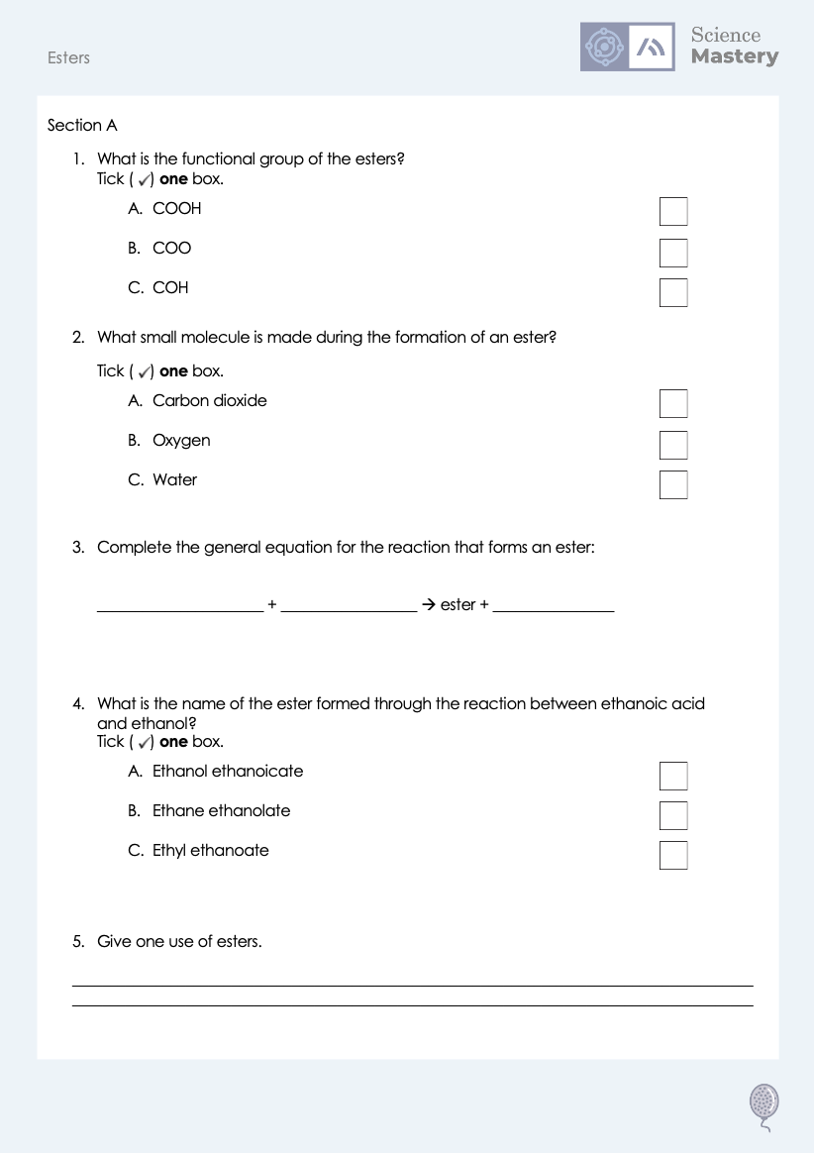
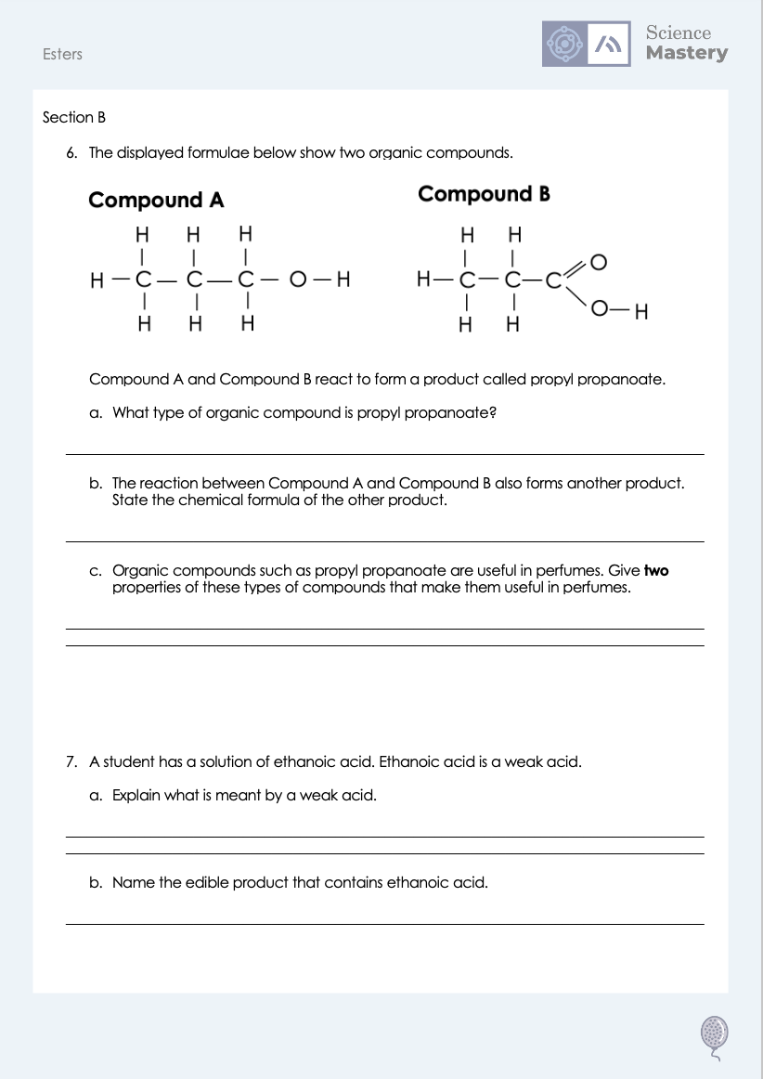
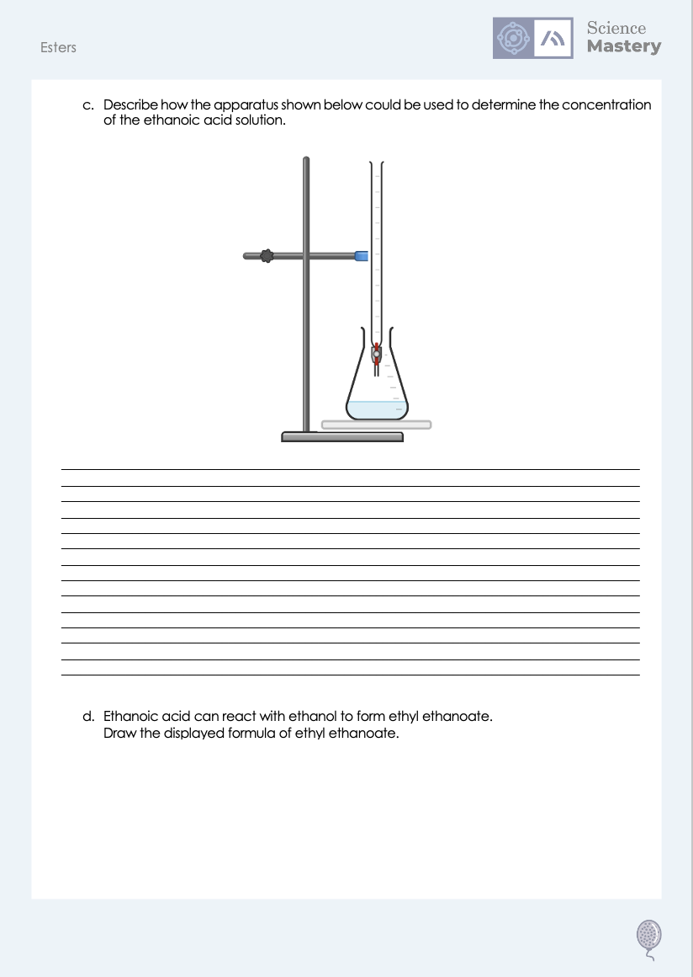
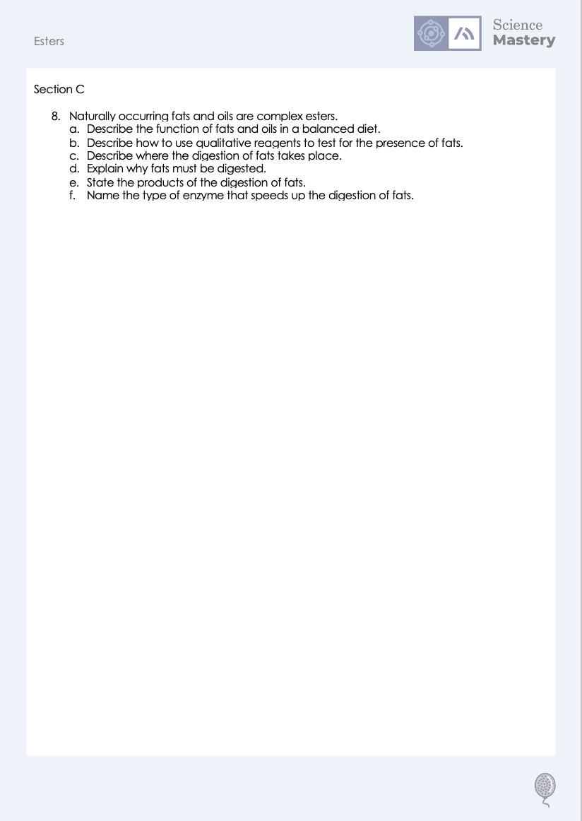
Worksheet

Slide 19
Answers
1. B - COO
2. C - Water
3. Alcohol + carboxylic acid → ester + water
4. C - Ethyl ethanoate
5. In scented products or as a solvent

Slide 20
Answers
6a. An ester
6b. H₂O
6c. They have fruity/pleasant smells, are highly volatile and are useful as solvents
7a. An acid that only partially ionises/dissociates in solution
7b. Vinegar

Slide 21
Answers
7c. Suggested points (for full credit, method must lead to a valid outcome)
Add a (named) alkali in burette
alkali concentration should be known
add known volume of acid to conical flask
several drops of indicator should be added to acid
on top of white tile
add alkali to acid dropwise from burette
swirl
watch for colour change of indicator
measure volume of alkali needed to neutralize acid
calculate unknown concentration of acid
7d.
H
H
O
H
H
C
C
O
C
C
H
H
H
H

Slide 22
Answers
8a. To provide energy (from storage)
8b. Add ethanol to the food sample to dissolve the fat then add water. A positive result is that a white emulsion forms.
8c. It begins in the stomach and continues in the small intestine.
8d. They are large insoluble molecules so must be broken down to form small soluble molecules so they can diffuse across the wall of the small intestine and into the bloodstream.
8e. Glycerol and fatty acids
8f. Lipase

Slide 23
Answer the questions below.
What are the reactants needed to make an ester?
A. An alcohol and an alkene
B. A carboxylic acid and an alkene
C. An alcohol and a carboxylic acid
✓
What is the name of the ester formed from ethanol and ethanoic acid?
A. Ethanol ethanoate
B. Ethyl ethanoate
C. Ethyl ethanoic
✓
What is a use of esters?
A. As a fuel
B. In alcoholic drinks
C. In scented products
✓
Notes:
Q1. Answer: C
If students answer A or B, they are not clear on the reactants needed to produce an ester. To fix-it, review the general equation for the formation of an ester.
Q2. Answer: B
If students answer A, they have recognised the second part of the ester name but not the first. If students answer C, they have recognised the first part of the ester name but not the first. To fix it, review the naming convention used for naming esters. Students are only expected to know ethyl ethanoate but an understanding of the naming can help consolidate the reactants that were involved.
Q3. Answer: C
If students answer A or B, they are not clear on the uses of esters versus alcohols. To fix it, review the uses of different homologous series.

Slide 24
Lesson C5.1.11
What was good about this lesson? | What can we do to improve this lesson?
Send us your feedback by clicking this link
or by emailing sciencemastery@arkonline.org
Thank you!

